Slide 1
DATA STRUCTURES
Sorting

Slide 2
Shell Sort

Slide 3

Shell Sort: Idea
Donald Lewis Shell (1959) : The idea behind this sorting technique is exchange items that are far apart!
Shellsort, also known as Shell sort or Shell's method, is an in-place comparison sort. It can be seen as either a generalization of sorting by exchange or sorting by insertion. The method starts by sorting pairs of elements far apart from each other, then progressively reducing the gap between elements to be compared.

Slide 4
Shell Sort: Idea
Shellsort, also known as Shell sort or Shell's method, is an in-place comparison sort.
It can be seen as either a generalization of sorting by exchange or sorting by insertion.
The method starts by sorting pairs of elements far apart from each other, then progressively reducing the gap between elements to be compared.

Slide 5
Shell Sort: Idea
Shell sort is a sorting algorithm that is highly efficient and is based on the insertion sort algorithm.
This algorithm avoids large shifts, as in insertion sort, where the smaller value is on the far right and must be moved to the far left.

Slide 6
Shell Sort: Idea
Original:
40
2
1
43
3
65
0
-1
58
3
42
4
5-sort: Sort items with distance 5 element:
40
2
1
43
3
65
0
-1
58
3
42
4

Slide 7
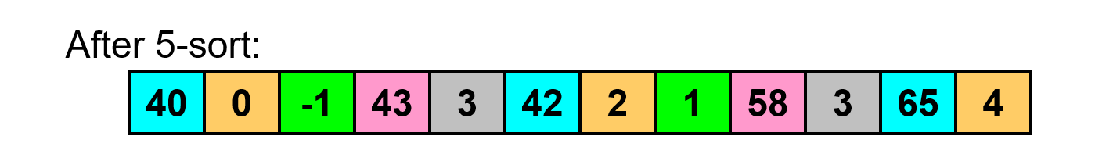
Shell Sort: Idea
Original:
40
2
1
43
3
65
0
-1
58
3
42
4
5-sort: Sort items with distance 5 element:
40
2
1
43
3
65
0
-1
58
3
42
4

Slide 8
Shell Sort: Idea
Original:
40
2
1
43
3
65
0
-1
58
3
42
4
5-sort: Sort items with distance 5 element:
40
2
1
43
3
65
0
-1
58
3
42
4

Slide 9
Shell Sort: Idea
Original:
40
2
1
43
3
65
0
-1
58
3
42
4
5-sort: Sort items with distance 5 element:
40
2
1
43
3
65
0
-1
58
3
42
4

Slide 10
Shell Sort: Idea
Original:
40
2
1
43
3
65
0
-1
58
3
42
4
5-sort: Sort items with distance 5 element:
40
2
1
43
3
65
0
-1
58
3
42
4

Slide 11
Shell Sort: Idea
Original:
40
2
1
43
3
65
0
-1
58
3
42
4
5-sort: Sort items with distance 5 element:
40
2
1
43
3
65
0
-1
58
3
42
4

Slide 12
Shell Sort: Idea
Original:
40
2
1
43
3
65
0
-1
58
3
42
4
5-sort: Sort items with distance 5 element:
40
2
1
43
3
65
0
-1
58
3
42
4

Slide 13
Shell Sort: Example
Original:
40
2
1
43
3
65
0
-1
58
3
42
4
After 5-sort:
40
0
-1
43
3
42
2
1
58
3
65
4
After 3-sort:
2
0
-1
3
1
4
40
3
42
43
65
58
After 1-sort:
0
-1
1
0
2
1
3
2
40
3
43
3
65
43
4
42
40
65
43
42
58
43
65
58
65

Slide 14
Shell Sort: Gap Values
Gap: the distance between items being sorted.
As we progress, the gap decreases. Shell Sort is also called Diminishing Gap Sort.
Shell proposed starting gap of N/2, halving at each step.
There are many ways of choosing the next gap.

Slide 15
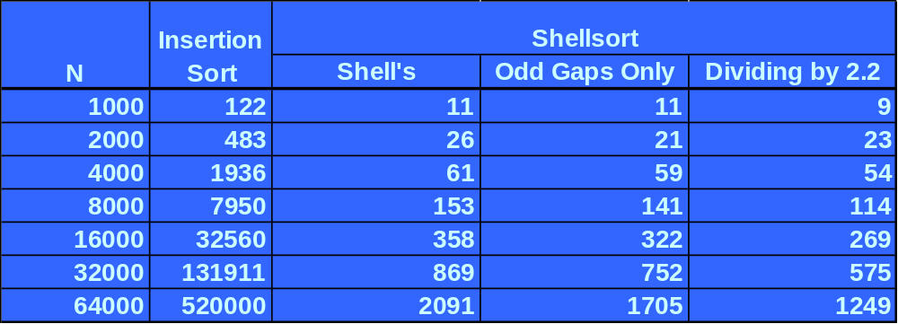
Shell Sort: Analysis
O(N^{3/2})? O(N^{5/4})? O(N^{7/6})?
So we have 3 nested loops, but Shell Sort is still better than Insertion Sort! Why?

Slide 16
Shell Sort : Algorithm
SHELL_SORT (A)
for h = 1 to h <= N/9 do
for (; h > 0; h != 3) do
for i = h +1 to i <= n do
v = A[i]
j = i
while (j > h AND A[j - h] > v
A[i] = A[j - h]
j = j - h
A[j] = v
i = i + 1

Slide 17
Shell Sort
Algorithm

Slide 18
void shell_sort (int *a, int n)
{
int h, i, j, k;
for (h = n; h /= 2;)
{
for (i = h; i < n; i++)
{
k = a[i];
for (j = i; j >= h && k < a[j - h]; j -= h)
{
a[j] = a[j - h];
}
a[j] = k;
}
}
}

